Slide 1
GRADE 1-EVS
TYPES OF FAMILIES
Presented by
. B. Jehanya
CLT Primary coordinator
SNS Academy
GRADE 1 / EVS / TYPES OF FAMILIES- NUCLEAR FAMILY / JEHANYA.B
05.08.2020

Slide 2
NUCLEAR FAMILY
When parents and their children live in a family, it’s called a nuclear family.
Only a few members live in a nuclear family.
It’s a small family.
GRADE 1 / EVS / TYPES OF FAMILIES- NUCLEAR FAMILY / JEHANYA.B

Slide 3
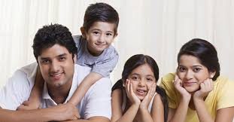
Nuclear families

Slide 4
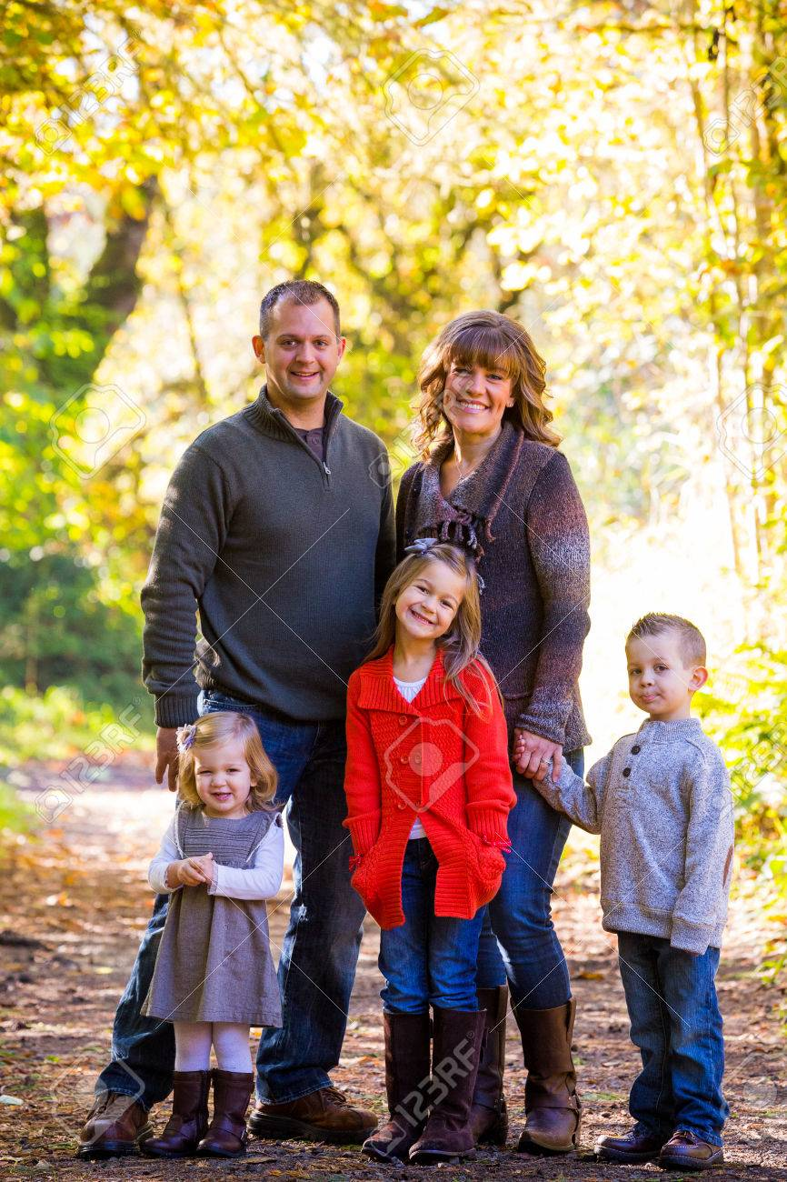
So, in a nuclear family :
Father and mother live with their children.

